Slide 1
WELCOME
Weekly Report
Vatsla Adhikari
Nov. 24, 2023

Slide 2
INDEX
Slide 1: Weekly Report
Slide 2: Index
Slide 3: Real-time Dataset Parameters
- List of parameters: Centre, Upper Left, Upper Right, Lower Left, Lower Right
- Visual representation of the parameters
Slide 4: Work with WAP
- Plot MTF vs Z profile
- Curves for all 5 points from the real-time dataset
- Calculate Delta Z and plot it on the graph
Slide 5: Pseudo Code and API Table
- Show Pseudo Code for Python Code
- Display API Table for the Python Code
Slide 6: Real-time Data and MTF vs Z Graph
- Display MTF vs Z graphs for 2 additional log files
- Enhance understanding through visualization
Slide 7: Delta Z Histograms
- Show histograms for every log file
- Delta Z on X-axis, Total number of images on Y-axis
Slide 8: Pseudo Code and API Table (Continued)
- Continue with the Pseudo Code and API Table for the Python Code
Slide 9: Summary
- Briefly summarize the key points
- Conclude the presentation

Slide 3
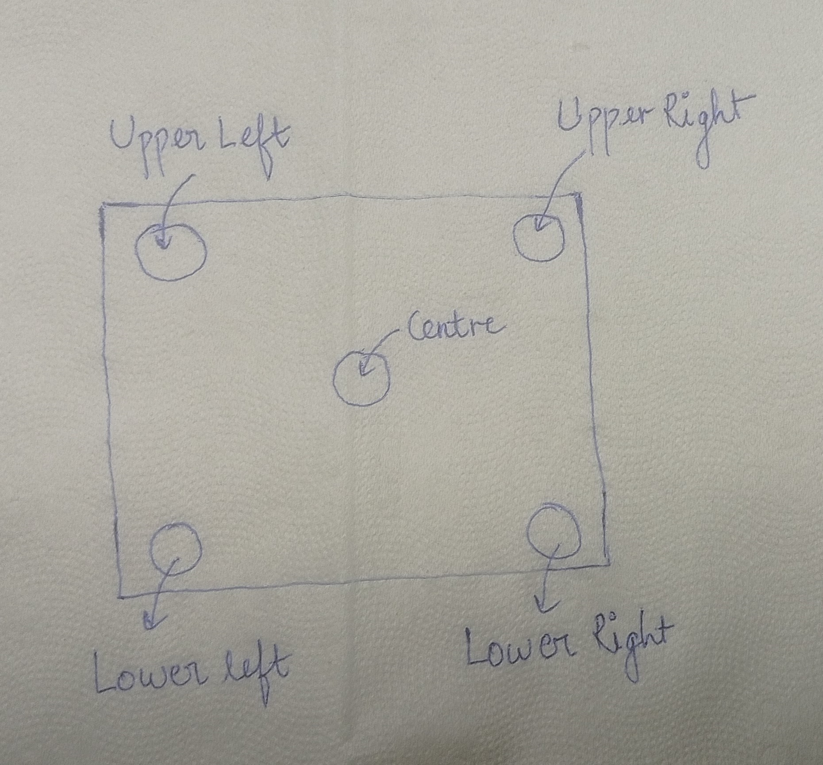
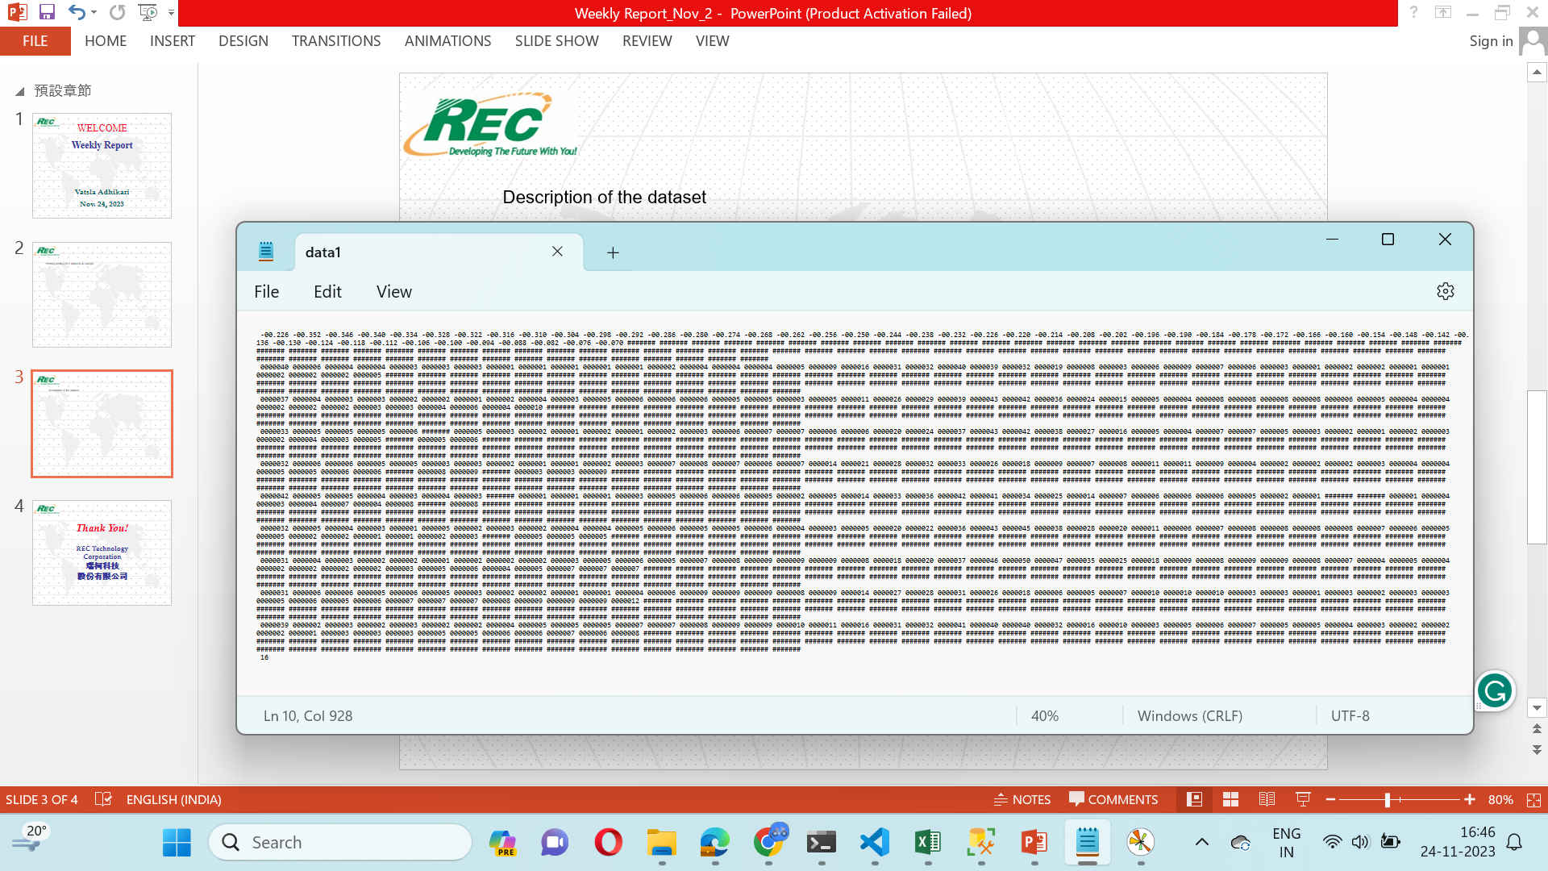
Reference Image
Objective: For visualisation purpose.
The real time dataset has these parameters: Centre, Upper Left, Upper Right, Lower Left and Lower Right
Objective: For visualisation purpose.
The real time dataset has these parameters: Centre, Upper Left, Upper Right, Lower Left and Lower Right
X-Axis
Centre
Upper Left
Upper Right
Lower Left
Lower Right
Brief explanation: Plot the first line(black box) as x-axis by skipping the hashes, then plot the second line(yellow box) as the centre curve by skipping the hashes, then for the remaining datasets(blue, orange, green and red box) skip the first 3 columns and the hashes, and for every 2 line in each colored box average the values to plot the remaining 4 curves.

Slide 4
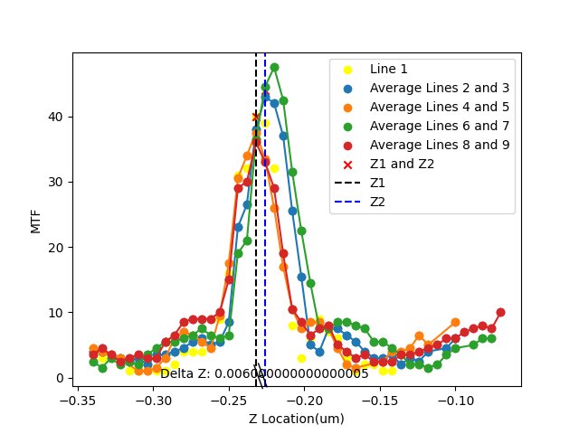
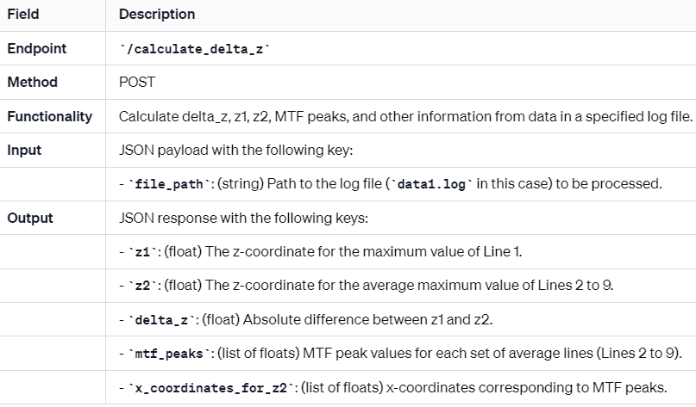
Objective: WAP;
To plot MTF vs Z profile
To plot the curves for all 5 points(for ref view previous slide)
To calculate the Delta Z and plot it on the graph.
Delta Z = absolute of [(x-coordinate for peak of centre) – (average of x coordinate for peaks of the 4 points)]
Reference API:
Reference Image:

Slide 5
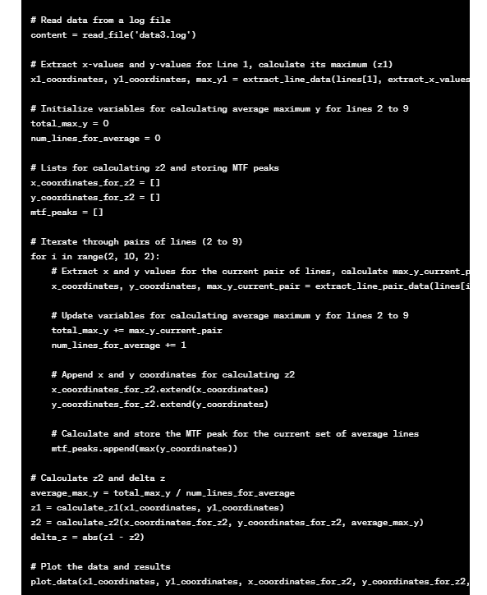
| Variable/Function | Description | Data Type | Return Type |
|--------------------------|---------------------------------------------------------|------------------|----------------------|
| content | Data read from the 'data3.log' file | String | N/A |
| lines | List of lines obtained by splitting content | List of Strings | N/A |
| x_values | Extracted x-axis values from the first line | List of Floats | N/A |
| x1_coordinates | X-coordinates for Line 1 | List of Floats | N/A |
| y1_coordinates | Y-coordinates for Line 1 | List of Floats | N/A |
| max_y1 | Maximum Y-value for Line 1 | Float | N/A |
| total_max_y | Accumulator for total maximum Y for lines 2 to 9 | Float | N/A |
| num_lines_for_average | Counter for the number of lines used in averaging | Integer | N/A |
| x_coordinates_for_z2 | X-coordinates used for calculating z2 | List of Floats | N/A |
| y_coordinates_for_z2 | Y-coordinates used for calculating z2 | List of Floats | N/A |
| mtf_peaks | List to store MTF peaks for each set of average lines | List of Floats | N/A |
| average_max_y | Average maximum Y for lines 2 to 9 | Float | N/A |
| z1 | Calculated Z1 value | Float | N/A |
| z2 | Calculated Z2 value | Float | N/A |
| delta_z | Absolute difference between Z1 and Z2 | Float | N/A |
| extract_x_values | Function to extract x-axis values from a line | String | List of Floats |
| extract_line_data | Function to extract x and y coordinates for a line | String, List | List of Floats |
| extract_line_pair_data | Function to extract x and y coordinates for a line pair | String, String, List | List of Floats |
| calculate_z1 | Function to calculate Z1 value | List, List | Float |
| calculate_z2 | Function to calculate Z2 value | List, List, Float | Float |
| plot_data | Function to plot data and results | List, List, List, List, Float, Float, Float, Float, List, Float | N/A |
Objective: To show the pseudo code and the API table for the actual python code.
This table provides a structured overview of the variables, functions, and their respective descriptions, data types, and return types in the given code.
This summary captures the key steps of the script: reading data, extracting information, calculating z1 and z2, and plotting the results. Specific details of functions and implementations are omitted for brevity.

Slide 6
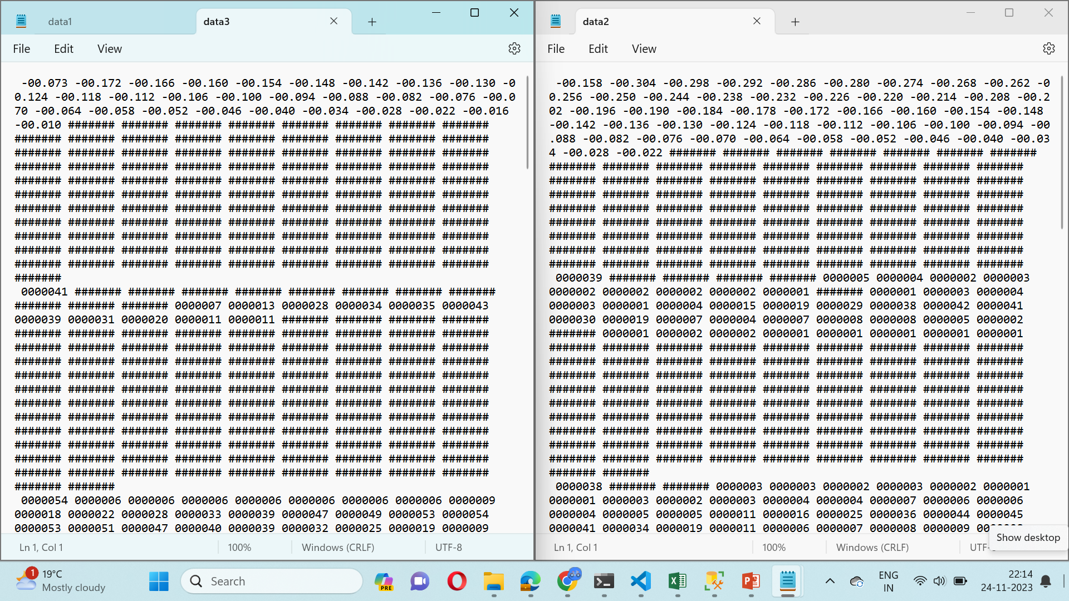
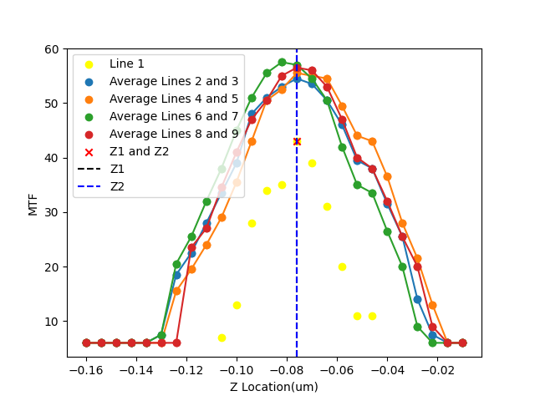
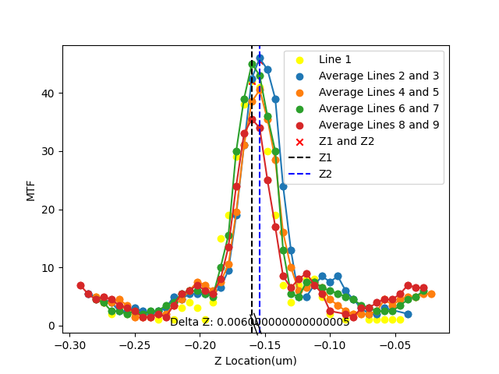
Objective: To show the real time data and the MTF vs Z graph for 2 more files. For better understanding.

Slide 7
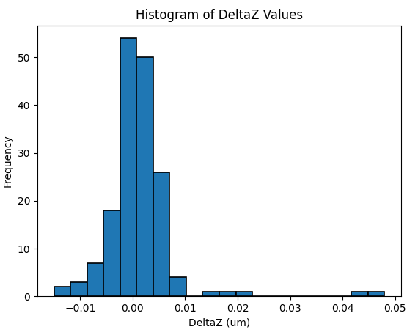
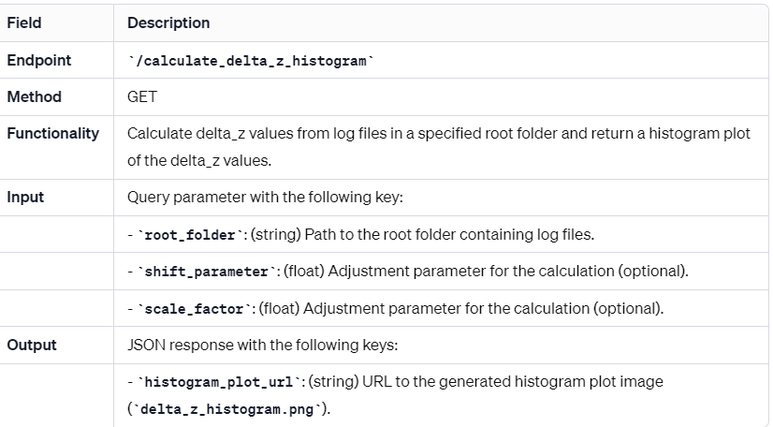
Objective: To print histograms for every log file.
Representation with the DeltaZ(X-axis)
and total number of images for that
DeltaZ(Y-axis)
Reference API:

Slide 8
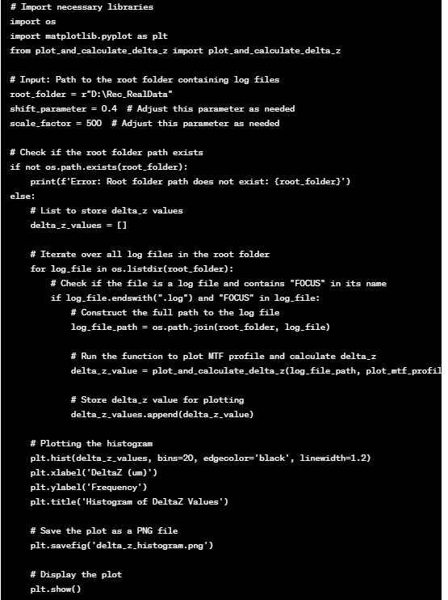
Objective: To show the pseudo code and the API table for the actual python code.
This pseudocode outlines the main steps of the code, including importing libraries, setting input parameters, iterating through log files, calling the external function `plot_and_calculate_delta_z`, storing results, and plotting a histogram of delta_z values. Adjustments to parameters can be made as needed.
| Variable/Function | Description | Data Type | Return Type |
|-------------------------- |-----------------------------------------------------------------|------------------|----------------------|
| root_folder | Path to the root folder containing log files | String | N/A |
| shift_parameter | Parameter for adjusting the MTF plot (adjust as needed) | Float | N/A |
| scale_factor | Parameter for adjusting the MTF plot (adjust as needed) | Float | N/A |
| delta_z_values | List to store calculated delta_z values for each log file | List of Floats | N/A |
| log_file | Iteration variable for log files in the root folder | String | N/A |
| log_file_path | Full path to the current log file | String | N/A |
| delta_z_value | Result of calling the plot_and_calculate_delta_z function | Float | N/A |
| plot_and_calculate_delta_z | External function to plot MTF profile and calculate delta_z | String, Boolean | Float |
This table provides a structured overview of the variables, parameters, and functions in the given code, along with their respective descriptions, data types, and return types.

Slide 9
Objective: To show all the work in brief.
1. Every image captured by the sensor will be read by the machine like this.
3. Every log file will have a MTF vs Z graph with the indication of Delta Z in it.
2. Every image will be mathematically or coding wise be read from this log file format.
4. Then a histogram will be plotted for multiple log files from a folder.

Slide 10
Thank You!
REC Technology
Corporation
瑞柯科技
股份有限公司

